Slide 1
Total Availability with PostgreSQL and multi-master replication
Wagner Corrêa Ramos
Anderson Massaharu Shibata

Slide 2
Schedule
Shibata Group Overview (5 min)
PostgreSQL in Centralized and Master-Slave ways (5 min)
PostgreSQL in Multi-Master way (20 min)
Pros and Cons of each approach (10 min)
Comments and questions

Slide 3
PostgreSQL in Multi-Master way
Why search for a Multi-Master approach ?
Frequent network link problems
2009: 2 central server down events, each one translated in 6 hours without back-office systems (one event close to Christmas)
2009: Many periods of central server slowdown, first signs that master-slave approach could be not sufficient for the present and least for the future, thinking about in Shibata growing.
On master-slave approach, the back-office system usage on network break events is not satisfactory, giving to the remote stores users just query option, not updates, so the systems come only partially available. Users always want more, so Shibata IT starts looking for a total availability solution.

Slide 4
PostgreSQL in Multi-Master way
The first attempt to multi-master approach was with PgCluster but without success (install and administration complexity without a skilled technical support)
Why ObjectMMRS ? What features makes the choice ?
Asynchronous replication method, supporting internet issues.
Flexibility and transparency: No problems on PostgreSQL version mix between central and stores, CDC (change-data-capture) based on standard triggers, documented internal data dictionary.
Low overhead: Despite triggers CDC overhead, the data distribution is very light. The server load when compared with Slony-I replication was lower.
Easier install and administration when compared with other multi-master solutions.
Skilled technical support

Slide 5
PostgreSQL in Multi-Master way using ObjectMMRS
Multi-Master preparation
Testing the ObjectMMRS with SHIBATA RP involving 3 PostgreSQL servers and all main RP operations.
The RP database model use in all tables an artificial ID generated by sequences. To avoid INSERT conflict in multi-master operation we have 2 options: Alter all PKs inserting a store ID or work with IDs non conflicted ranges. We adopt the simplest, work with ID non conflicted ranges.
We decide to change all ID datatypes from INTEGER to BIGINT since some huge tables were near to overflow. The entire database model contains about 450 tables.

Slide 6
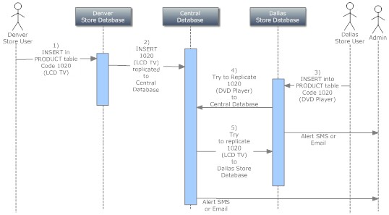
PostgreSQL in Multi-Master way using ObjectMMRS
Multi-Master INSERT conflict problem example

Slide 7
PostgreSQL in Multi-Master way using ObjectMMRS
Multi-Master preparation
For UPDATE conflict problem we had 2 options: Isolate UPDATE potentially conflict operations to be used just in one server (simultaneously), or activate ObjectMMRS resource of dealing with UPDATE conflicts. The choice was to isolate UPDATE potentially conflict operations. It was the simplest option.
In Multi-Master when possible deal with UPDATE conflicts just avoiding them. It is like a partitioned database, where each location updates their own data or potentially conflict operations are only executed in central database.

Slide 8
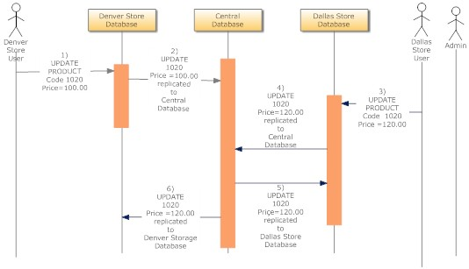
PostgreSQL in Multi-Master way using ObjectMMRS
Multi-Master UPDATE conflict problem example

Slide 9
PostgreSQL in Multi-Master way using ObjectMMRS
Multi-Master preparation
The Shibata RP does not make use of triggers, so the only triggers in RP database after ObjectMMRS installation was the CDC triggers.
We left about 2 months testing, adapting database model and application and planning for “go live” day.
It is very important to do exhaustive tests before go running multi-master.
Multi-Master adoption in Shibata was facilitated because they have full domain about their software application. It was quickly to find and treat the potential conflict operations.

Slide 10
PostgreSQL in Multi-Master way using ObjectMMRS
Followed steps about changing from Master-Slave to Multi-Master
Without stopping Slony-I replication, we did all ObjectMMRS engine installation and configuration in all servers (central and stores servers)
We did the ObjectMMRS data dictionary creation in all databases (central and stores servers)
We created all CDC triggers with the TriggerGenerator utility of ObjectMMRS.
After everything installed, configured and checked we stop the RP system and the Slony-I replication. We stayed a total of 1 hour with database replication stopped, but only 5 minutes with the RP stopped. (only the time needed to activate ObjectMMRS triggers and empty Slony-I replication queue)
During 3 days we follow using the RP still in master-slave approach. The objective was to check if everything was working properly and compare server load with the Slony-I replication.

Slide 11
PostgreSQL in Multi-Master way using ObjectMMRS
Finally Multi-Master
After 3 days of master-slave usage and databases working properly we decided to move the first store in production to multi-master mode.
After one day following up the first store multi-master usage, we decided to change all the other stores to multi-master one by one day after day.
The central server was shifted from a prime role to a contingence role, being used only when the local database server stops.

Slide 12
PostgreSQL in Multi-Master way using ObjectMMRS
Problems during the multi-master change process
At the beginning of multi-master usage, often users randomly alternated using the system on the local server to the central server and vice-versa, as they had the URL of both. With the normal delay that WAN replication have to propagate, the user sometimes called the support telling that the system "lost" data, because it had inserted something in the local and then, a moment later (before propagation), did not found the data in the central base.
We could have blocked access to the central server to avoid this problem, but it was solved simply by assisting the user to always use the local server, switching to the central server only when there is a statement from IT.

Slide 13
PostgreSQL in Multi-Master way using ObjectMMRS
Multi-Master Immediate benefits
Compliments from the end user saying that the system was fast as ever before. (It is the result of using a local network system instead of WAN)
End User will never know if the internet link is down or not. The user continues using the system in local network
You can stop the central server for maintenance, tunning, etc., for a few minutes or hours without impacting the operation.
You can do the same with local servers asking users to temporarily use the central server.
Network traffic decreased, leaving more bandwidth for other uses

Slide 14
PostgreSQL in Multi-Master way using ObjectMMRS
Operating on a daily basis
The ObjectMMRS has a Web tool that monitors to check that all servers are online and shows the queue size to replicate.
Warning emails are sent to the DBA in case of problems.
In the event of hardware failure of the local server:
The users start using the central server while the local server is down for maintenance
If the local server can not be recovered, a pre-configured backup server is put in place. There are 3 backup servers always updated by the replication software.
After replacing the server, users return to use the local server
Zero downtime and high database availability.

Slide 15
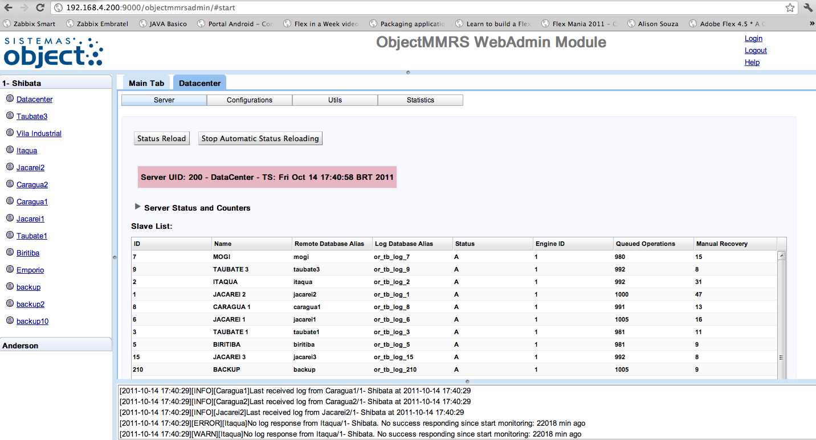
PostgreSQL in Multi-Master way using ObjectMMRS
Screenshot of ObjectMMRS Control Panel: Monitoring Replication Status and Queues

Slide 16
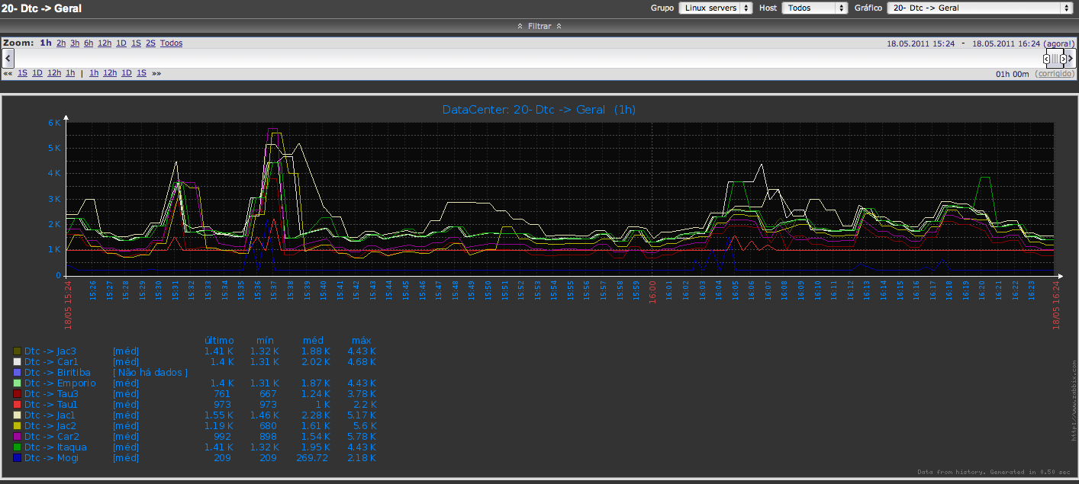
PostgreSQL in Multi-Master way using ObjectMMRS
Screenshot of Zabbix chart of replication queues

Slide 17
Pros and Cons of each approach
Analized item | Centralized database | Master-Slave (Slony-I) | Multi-Master (ObjectMMRS)
Architecture | Simple | Medium | Complex
Total downtime risk | High | Medium | Zero
Partial downtime risk | High | Medium | Zero
Necessary Network bandwidth | High | Medium | Low
Necessary Network stability | High | Medium | Low
Central Server Overhead | High | Medium | Low
General costs | High | Medium | Low

Slide 18
About ObjectMMRS
Technology
Lazy update anywhere protocol with timestamp update conflict detection and resolution
Licensing
Commercial annual license including upgrades and email support
Corporate – Unlimited server installations
Enterprise – More than 1 million INSERT/UPDATE/DELETE operations / day.
Standard – Less than 1 million operations / day. Pricing starting at US$ 590 annual.
Mobile – SQLite databases in smartphones, tablets, etc. Pricing starting at US$ 6.
Professional Services
Training
Database and application verification, Proof-of-concept, Installation
Technical support (Phone, Remote Access, Chat, Local)

Slide 19
Questions and comments

Slide 20
Thank you !
Contacts
wagner@object.com.br
anderson@object.com.br
www.object.com.br
www.objectmmrs.com
www.shibata.com.br

